Slide 1
Toggle Switches

Slide 2
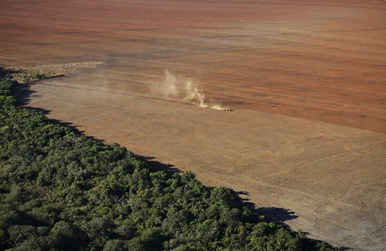
Dieback of Amazon Rainforest
Irreversible
Many animals and plants will die
Native people won´t have food anymore
Expansion of the deserts
Trees don´t take CO2 out of the air anymore

Slide 3
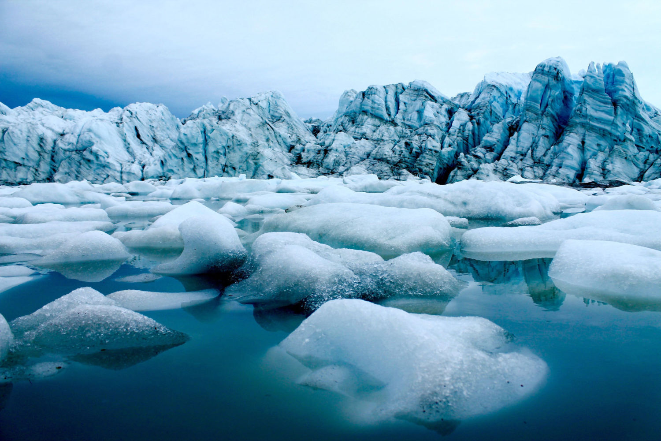
Melt of the Greenland Ice Sheet
Greenhouse effct is getting stronger, because of the loss of the reflection
Raises the sea level up
Stops the golf stream
Repercussions for the Fishing sector

